Slide 1
Evaluation
In what ways does your media product use, develop or challenge forms and convections of real media of real media products

Slide 2
Tittle of Magazine
We struggled to pick the tittle of the magazine, we came up with a few names but after an hour of trying to pick one we asked our teacher what name should we use, and he said ‘Fresh’ and we instantly liked it.
As our magazine is an R&B magazine the name sounds and looks like a name you would see in a real R&B magazine as its different but also catchy. We found it harder to come up with a name because it was a difficult genre as we didn’t want the magazine name to sound to ‘Pop’ or to ‘Hip Hop’ and ‘Fresh’ sounds right for an R&B magazine. The decision to make the colour blue was done before I started the magazine as I wanted to use simple colours that contrasted to one another, so blue and black contrast with one another, and because blue is a bright colour it stands out so one of the first things you see when you pick up the magazine would be the title of the magazine. There was a lot of different shades of blues that I tried and none of them looked right apart from this one, so I made sure the some of the cover stories were written in this shade of blue to make the cover look more organised.

Slide 3
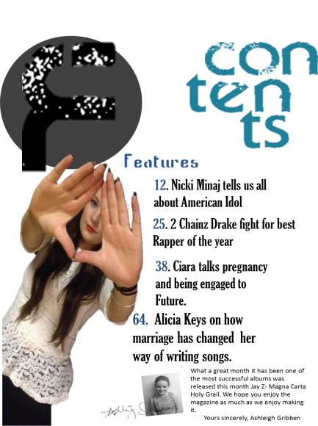
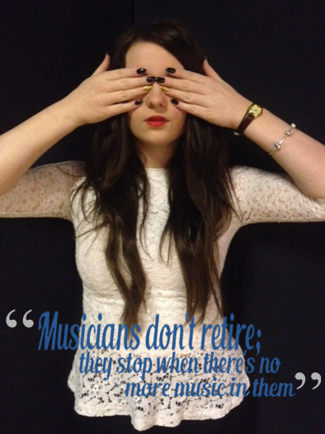
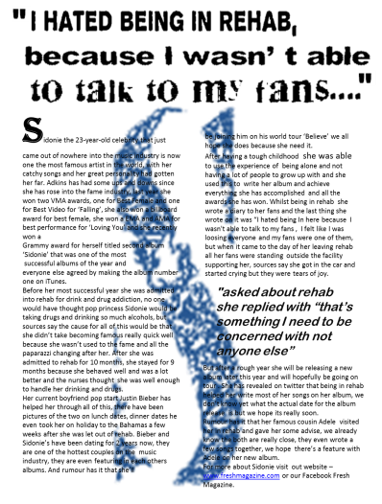
Mise-en-scene of images
I’m using the cover page the consents page and the first part of the double spread page. The main image is on the front cover, and I decided not to have any background to make it stand out even more, and also with the bright colours it contrasts with the white top she is wearing and the colour of her hair. The lighting of my mode, I have used high key lighting to make her look brighter which makes the cover very different to other covers. On the contents I used a bigger picture to remember the reader that this magazine article is about Sidonie, and it also takes up the whole page, but because of the pose she is doing it makes it look more interesting and as soon as you open the magazine the first thing you see is Sidonie. And the double spread I kept it simple but I also made it interesting, because the background is black it makes the model stand out even more, and it also contrasts with the writing which is a bright blue. Because my genre is R&B I made sure it didn’t look like a pop magazine and made it very R&B by having her doing a pose you would normally see, for example the front cover her hand is on her face and her eyes are closed, which makes her stand out, and I made it a similar pose on the double spread page so both pictures link.

Slide 4
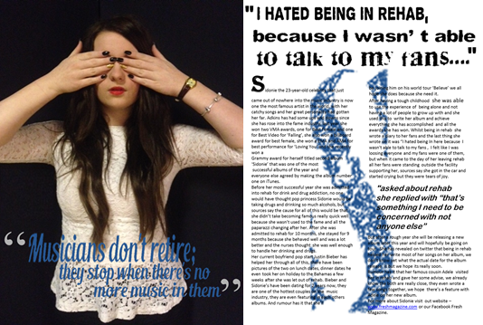
Costume and Props
I’m using the double spread page to analyse the costume and props, as the double spread page shows the whole costume, which again contrasts with the background and the bright colours, and because its an R&B magazine I made her wear dark colours that contrast with each other. Even thought you can’t see the rest of what she is wearing I did take some pictures where you can see all of her outfit, and she is wearing a black skirt, black tights and black shows, which contrast with the top half of what she was wearing, but it goes with the whole R&B genre as most of the themes contrast or are different which makes the magazine more interesting. I didn’t have time to do another photo-shoot where she was wearing something different, but as the magazine doesn’t have a lot of pictures of her its not as important, but if I had enough time I would done another photos-hoot to make it more interesting.

Slide 5
Layout and Style
For the layout I’m going to be using the cover page.
The layout of the cover page is very simple but still interesting, the reason I decided to keep it simple is because less is more, I didn’t want it to be full with a lot of writing, and also because it’s a simple close up shot picture I wanted to make sure the writing didn’t take over the page. I made the cover stories smaller than her name because that’s what its like with every magazine not just R&B. I have used a theme of simple colours which go together, for the writing I used a different font for each cover story, but also the typical elements you would see on an R&B magazine like the font, the cover stories which are mostly about R&B artist. I tried to make it as neat as possible because every magazine needs to look presentable for the reader. As the cover is the first thing the audience see and what makes them buy it, I made it as appealing as possible by the colours I used. Also the decision to have the main picture covering most of the magazine tittle was done over analysing other R&B magazines and most f them had the picture covering the magazine tittle, and we wanted to do this because it looks good and also because it shows that we are confident to know that our audience will know that this is ‘Fresh’ Magazine.

Slide 6
Written Content
The writing content I used was a simple one, I just talked about what my has achieved and has been through. I started with writing all of the good things she has achieved since she has been in the music industry for example all of the awards she has won and then in the middle I spoke about her struggles and what her downsides have been for example I wrote about her being in rehab, and then I ended it by writing about her getting out and writing an album, and about her relationship with her family friends and boyfriend. To make it seem like I didn’t make it up I used ‘sources say’ so it doesn't look like I knew all of this. Because my target audience is a young target audience I didn’t want to be really formal but also I didn’t want to be informal so I was a bit of both to make it more interesting. I used a couple of quotes to grab the readers attention, especially the one about rehab. I made the font size which was a size 11, but able to read so it looks like there's a lot to read, and I did this because I analysed a magazine where they did the same thing and it looked really good.

Slide 7
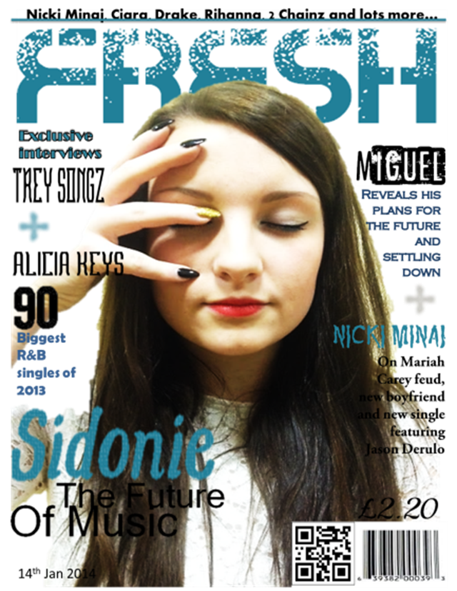
Music Genre
The music genre is shown on the cover magazine by the use of the all the R&B artist names and the “90 biggest R&B singles of 2013” makes it clear that it’s an R&B music magazine, the big quote about the R&B singles attracts the reader even more because it just tells you that the magazine knows the top 90 R&B singles, and it makes the reader want to buy the magazine and know the top R&B singles. The R&B genre is also shown the colours I haven used, R&B magazine covers tend to use dark colours and that’s exactly have I have used.

Slide 8
Contents Page
My contents page mainly informs the reader of what they will be reading about, I made it a simple contents page because I didn’t want a lot going on in one page. Having a picture of the same artist that’s on the cover makes it exciting and it reminds the reader who the main article is about.
We decided to have the big ‘F’ which is the initial of ‘Fresh’ our magazine name, to make remind the reader that they are reading ‘Fresh’ magazine and we decided to do this because of the research we did, when I analysed two contents pages they were both from the ‘Vibe’ magazine and they had a big ‘V’ on the contents page. And the way we laid out the word ‘Contents’ I also got this from the ‘Vibe’ magazine, this makes the contents page look different and interesting. And finally we decided to add and Editors note, to make the reader feel comfortable and want to read the magazine.

