Slide 1
Question 4: Who would be the audience for your media?
Clara Rodrigues

Slide 2
My target audience for my R&B music magazine, would be females and male between 15-25, it’s a young audience but everything I have done everything on my magazine to attract my target audience, and also by having a low price so its affordable as they don’t earn their own money. I would like to think that my target audience are all into a lot of R&B music and enjoy reading about R&B artists. The aim for my target audience is for them to appreciate the magazine and want to keep buying weekly, and also to try and get then to subscribe so the y get news about the magazine, and also for them to enjoy reading about the R&B artists.

Slide 3
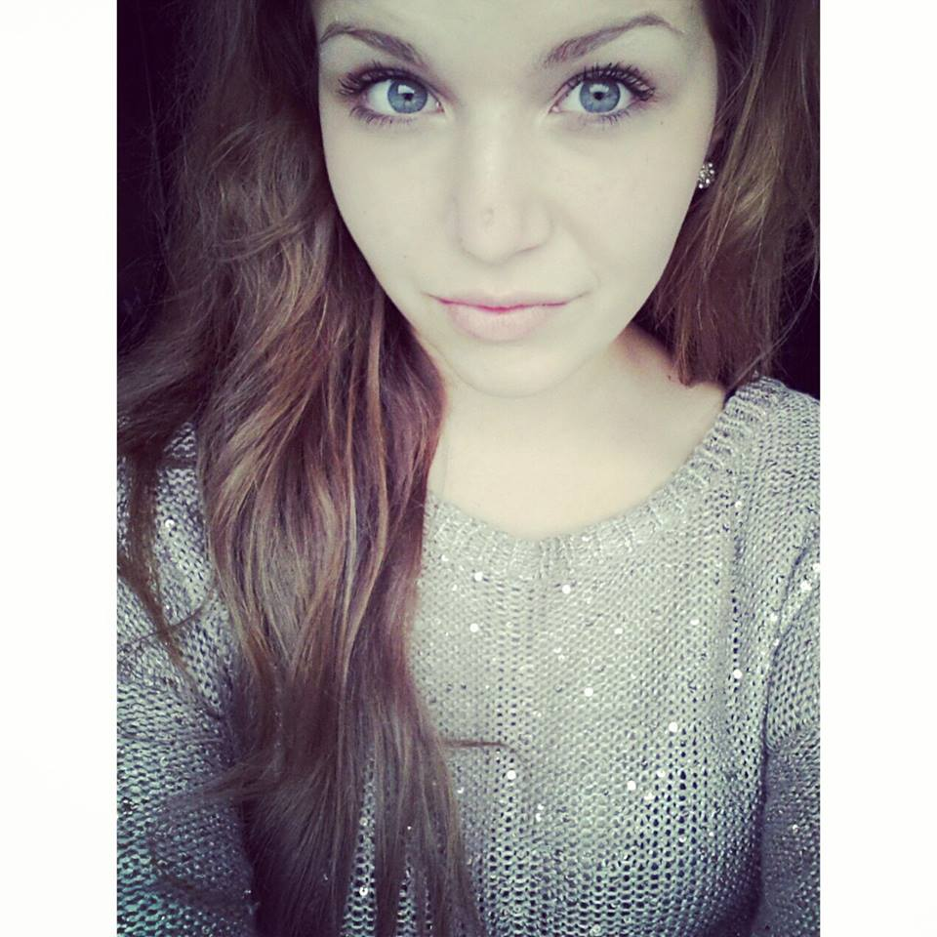
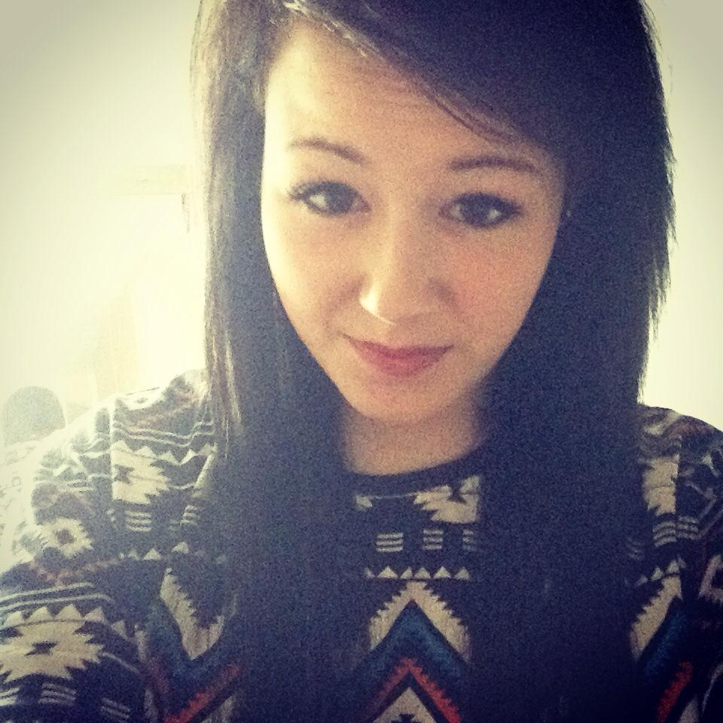
Name: Adrianna Karpiel Age: 17 Favourite Band/Artist: Rihanna Hobbies: Singing
Name: Kelsey Watkins Age: 16 Favourite Band/Artist: Paramore Hobbies: Reading

