Slide 1
Question 5: How did you attract/address your target audience?
By Clara Rodrigues

Slide 2
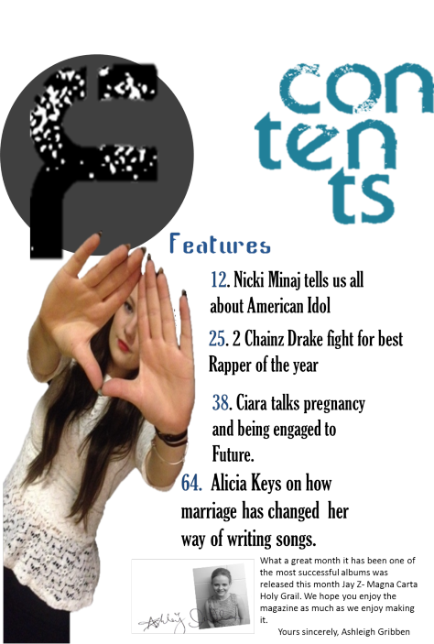
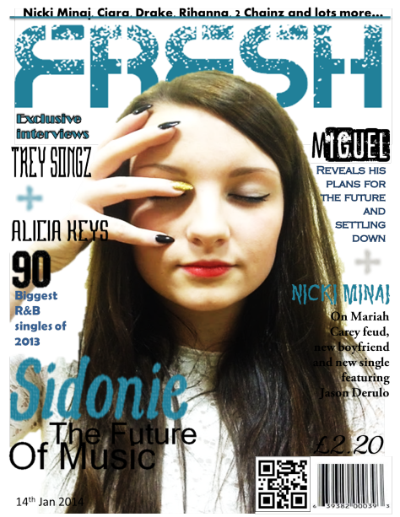
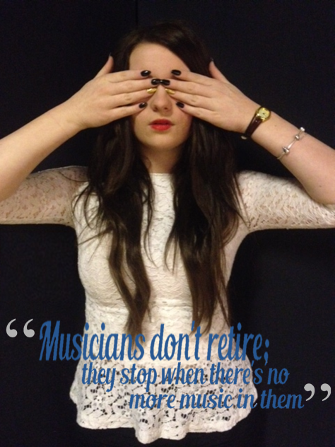
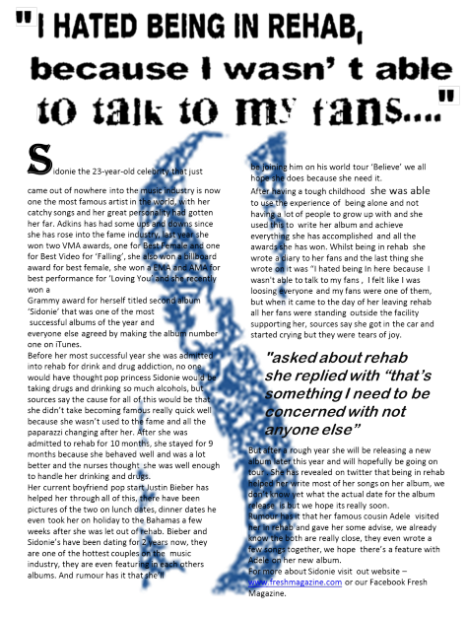

Slide 3
Front Cover
As my target audience is a young audience, they are into the new music and always know what’s new and they always know what’s number one so by having “90 biggest singles of 2013” at the front of the magazine, this attracts my target audience straight away, and will make them want to actually know what the 90 biggest singles of 2013 are. And also I made my price a low price of £2.00 as my target audience are teenagers to young adults who are still in school and are un-employed. The use of sub-stories attracts my target audience because it talks about other famous successful R&B artist and a glimpse what the magazine will be writing about them.
‘Exclusive Interviews’ suggests that these interviews are important and will make my audience want to read these interviews. My colour theme of blue, grey and white, attracts both female and male audience as it’s not to feminine or to masculine, blue fits both genders, and because the whole magazine is themed with these three colours it keep the target audience interested.

Slide 4
Contests Page
For my contents page I kept it very simple but enough to make the reader want to read these stories. The way the word ‘Contents’ is set out is very different and it makes the page look more interesting and will catch the readers eyes, I kept the colour scheme the same as the front cover to make the magazine look organised. I decided to have a plain background so everything on the page stands out, for example the big ‘F’ which would be the logo for our magazine ‘Fresh’ this stands out a lot because its in dark colours.
I decided to use the same model on the cover to remind the reader who the main article is about. Even though there isn’t a lot going on, I prefer it this way as I didn’t want a lot going on in one page, and I decided to do it this way because of the already existing magazines I have analysed and even thought there wasn’t a lot on the contents page it still kept me interested.
And lastly the font I have used are all different apart from the features, this will keep the audience interested and not bored because it wont be the same font every time.

Slide 5
Double Spread Page
My double spread page is very simple but there a few aspects that attract my audience. The big ‘S’ on the background attracts my audience as it’s one of the first things they will see as soon they open the double spread page, and it stands out because it’s the only blue thing on the page. Another thing that attracts the audience is ‘I hated being in rehab because I wasn’t able to talk to my fans…” this makes the reader want to know why she was in rehab and also when she was in rehab, but most of all it makes the reader want to read the article. I made the writing small so it looks like there’s a lot to know about the artist, and I put a quote in the middle, which also related to rehab and this attracts my target audience because normally before you start reading an article you like to look at the pictures and reading the quotes so it makes you more interested to the article and that’s exactly what I have done with the picture and the quote on the first page. I made the picture stand out by having her cover her eyes to represents that she wants to hide away after getting out of rehab and by having a quote underneath it which has a lot of means and it connects to her going into rehab.

